Slide 1
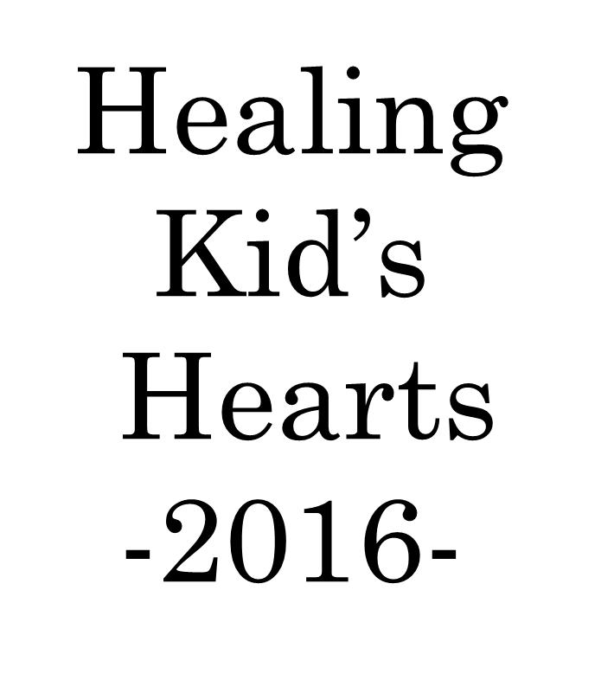
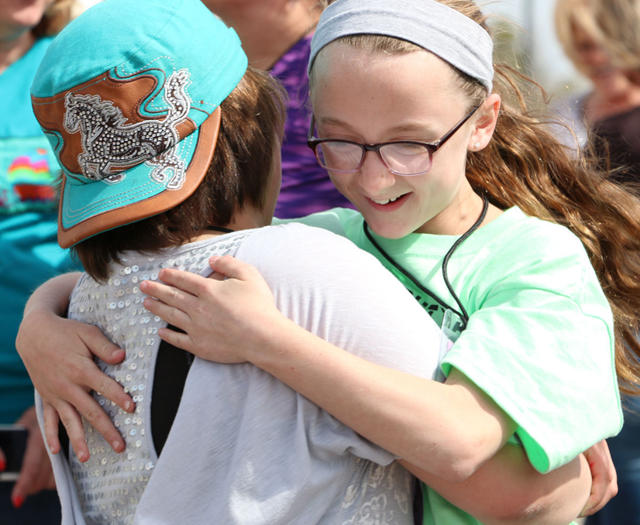
Sponsored by:
The Center for Life Experience

Slide 3
“Healing Kid’s Hearts Retreat” is a time to help children who have suffered the loss of a loved one to learn about, embrace, and cope with grief as they move forward in their journey of healing.
Trained community volunteers and professionals guide the children through a variety of activities to help them learn that there is no right way to grieve and heal from the loss. These volunteers listen and support the children as they explore their feelings and connect with other children who are experiencing other losses.
So here’s how it comes together…

Slide 4
Volunteer Training
A week prior to the retreat, dedicated adults spend a morning preparing and learning how to help and support children and their families.

Slide 5
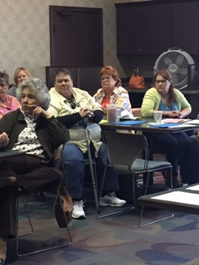

Slide 6
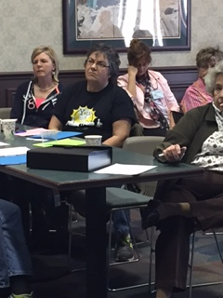

Slide 7
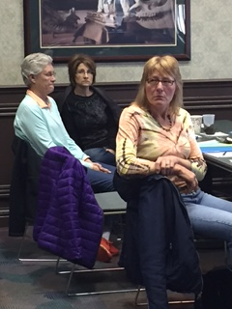

Slide 8
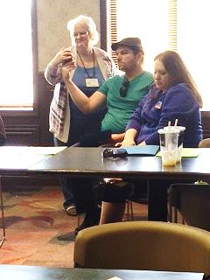

Slide 9
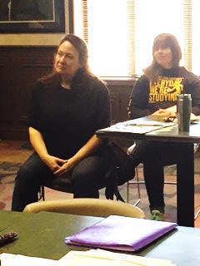

Slide 10
Parent’s Education
While the children spend time with their mentors, the parents and families have a special time for learning about the impact of grief and loss on their children and themselves.

Slide 11
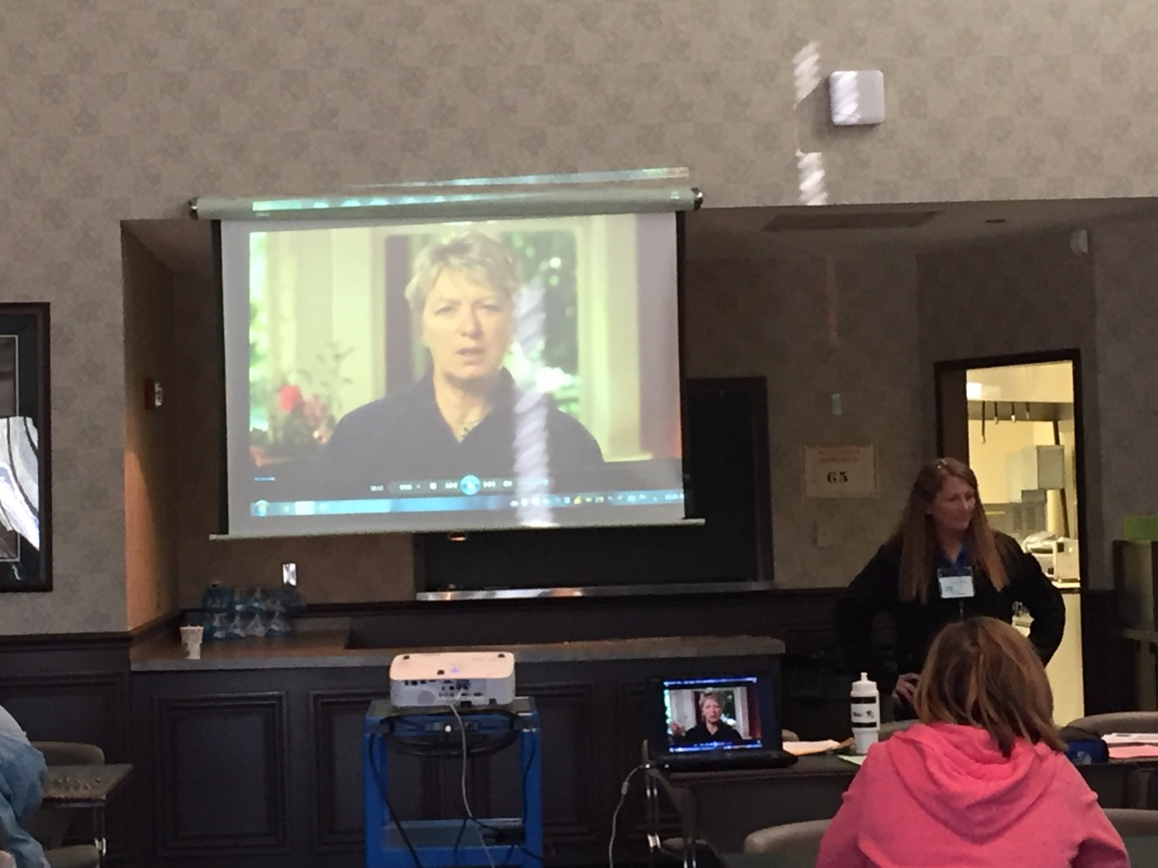

Slide 12
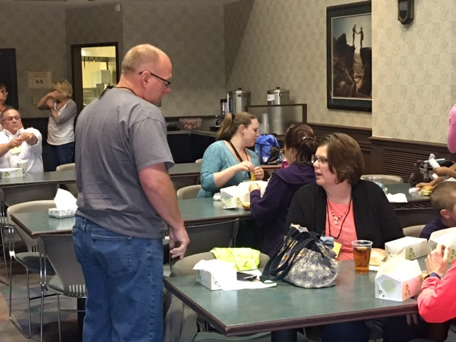

Slide 13
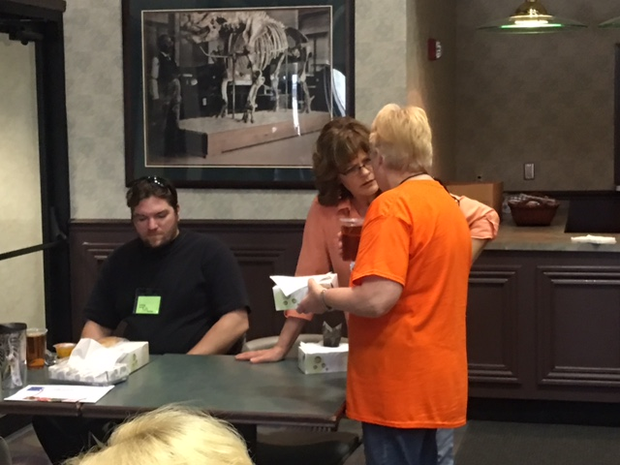

Slide 14
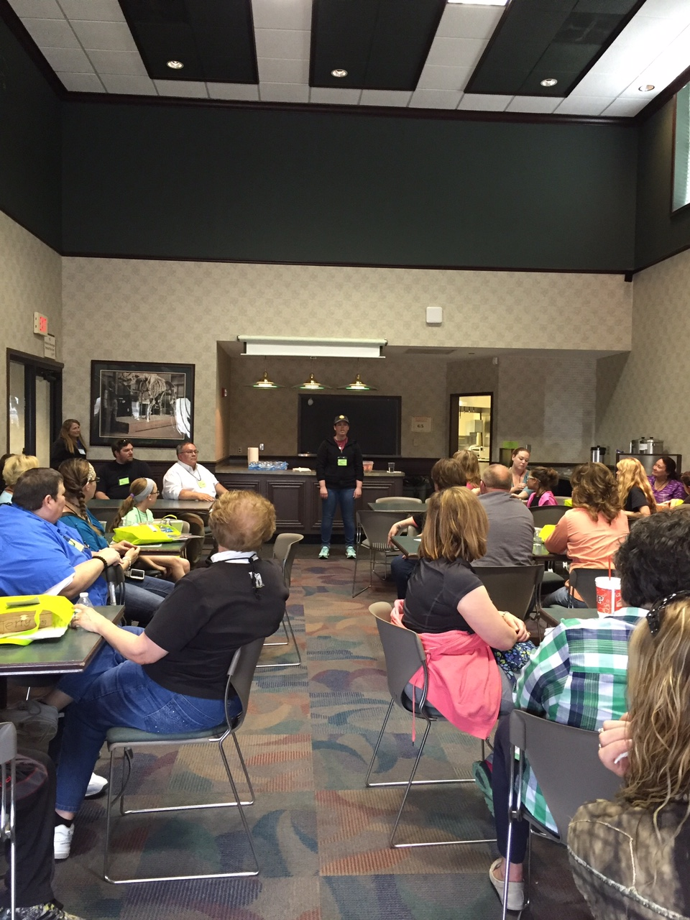

Slide 15
The first annual “Healing Kid’s Hearts Retreat” begins…

Slide 16
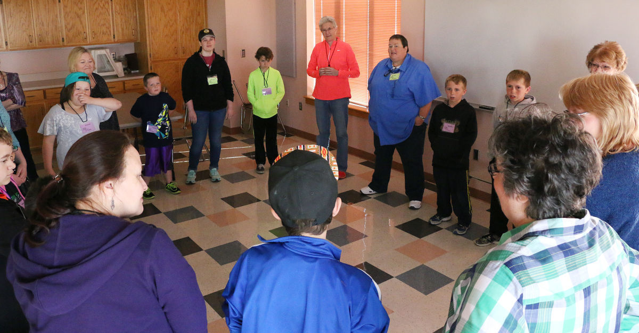
The day begins with an ice breaker activity.
Children and their retreat mentors getting acquainted at the start of the retreat.

Slide 17
After getting acquainted, the children and their mentors preserve and share special memories as they make:
Memory boxes
Scrapbook pages
Ornaments

Slide 18
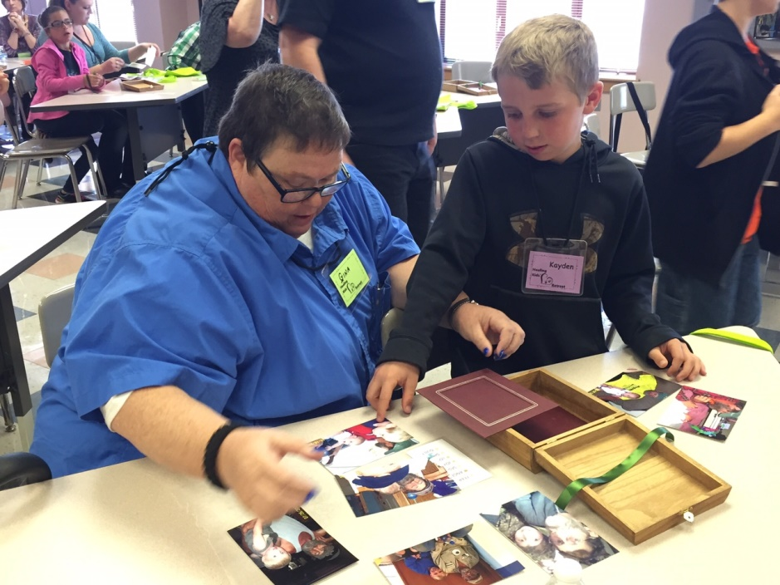

Slide 19
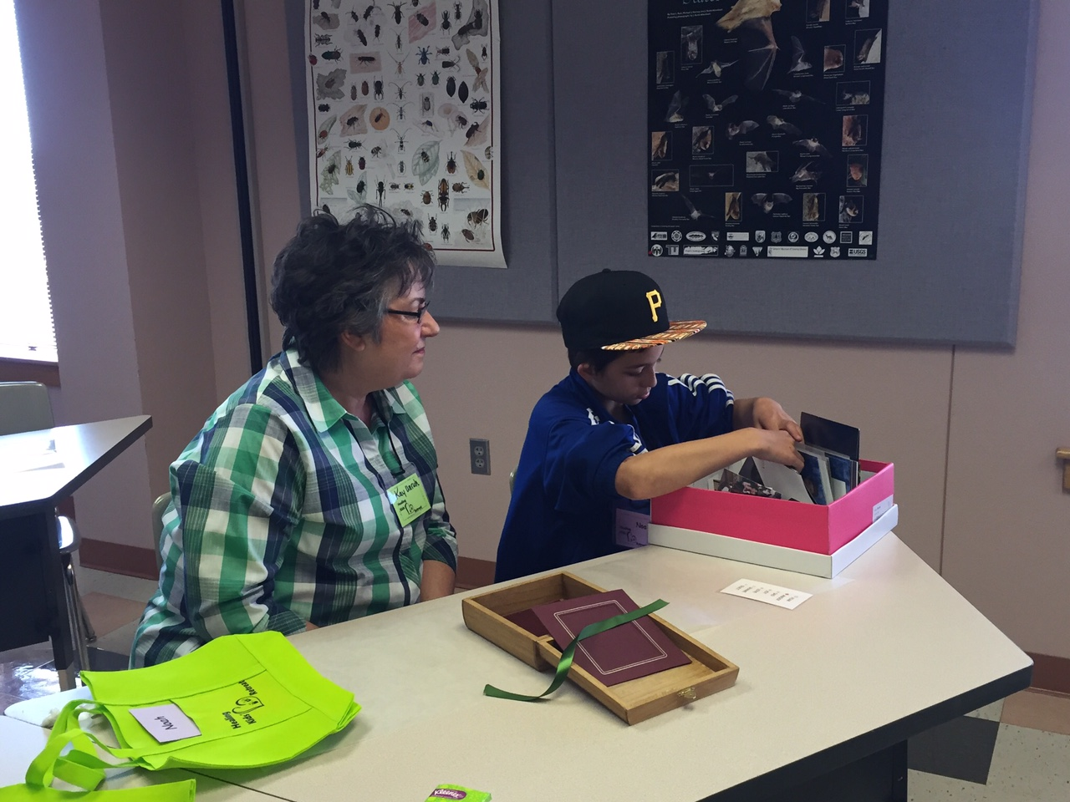

Slide 20
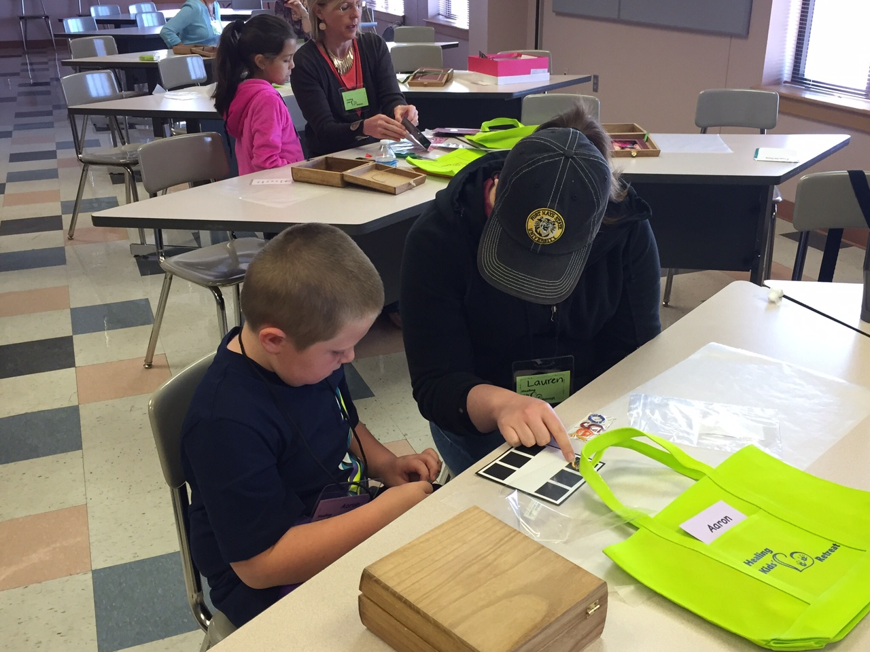

Slide 21
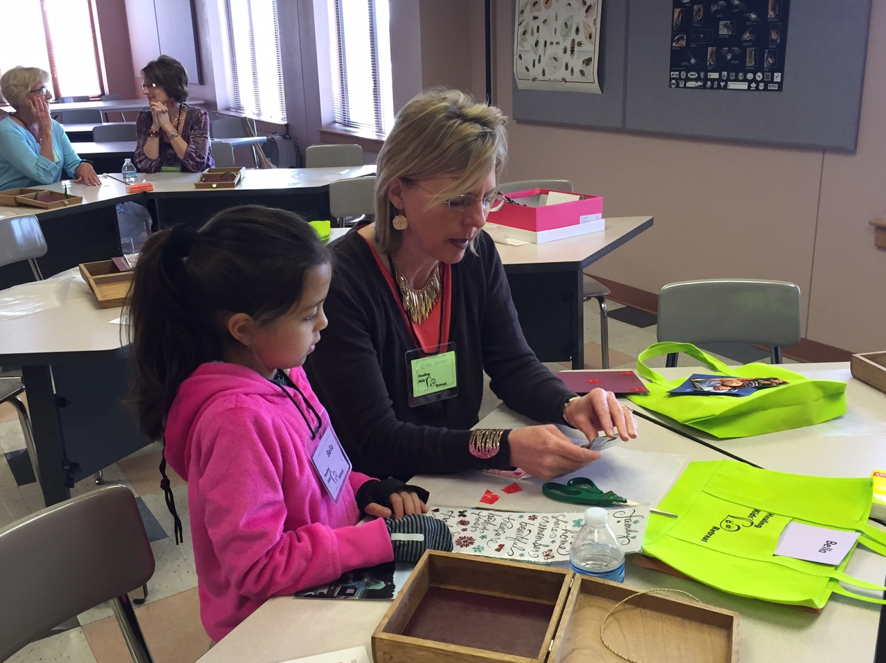

Slide 22
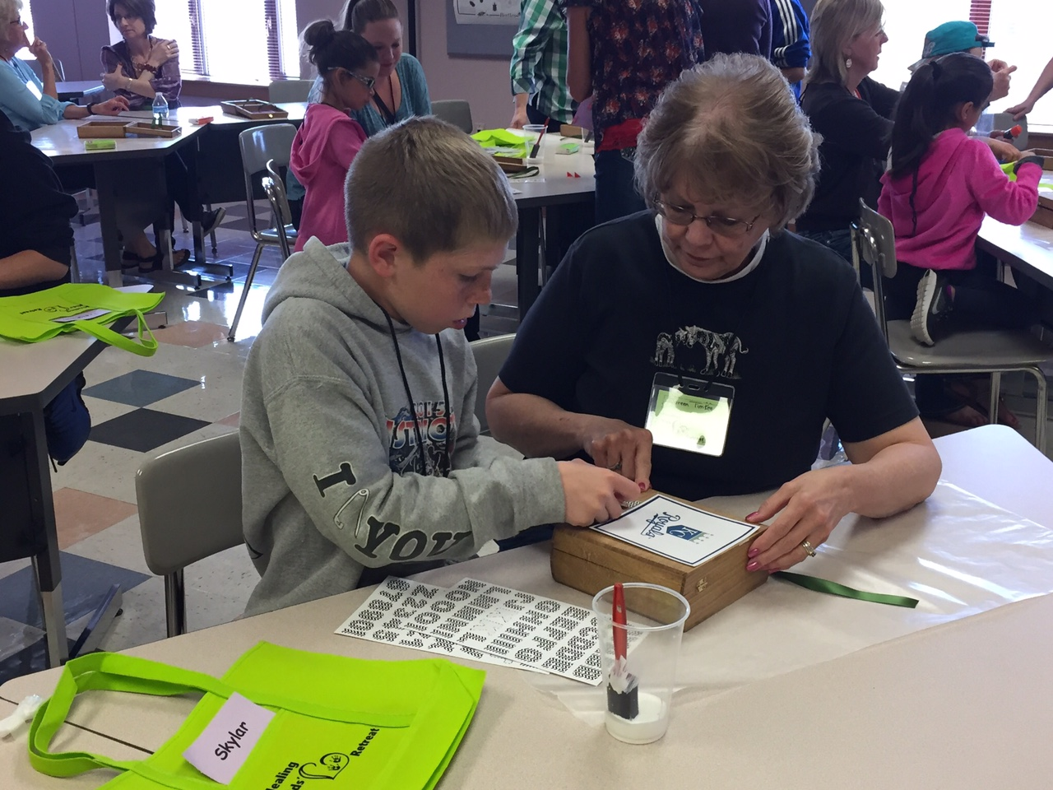

Slide 23
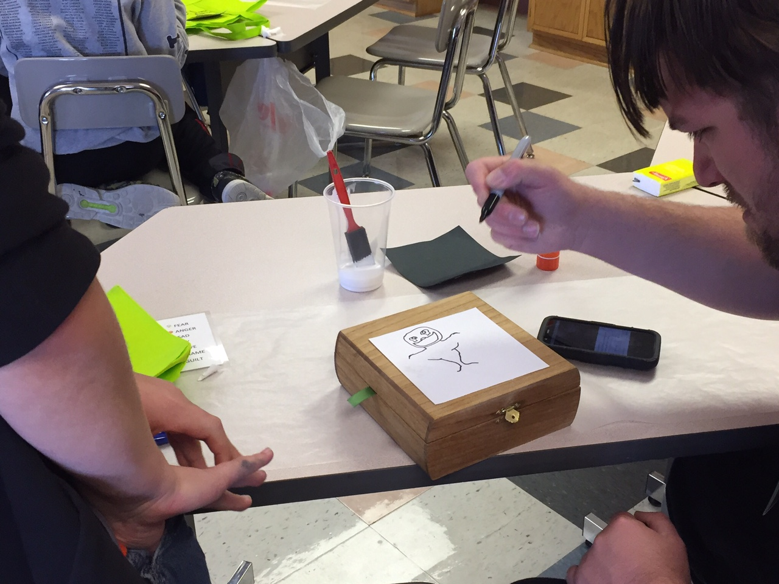

Slide 24
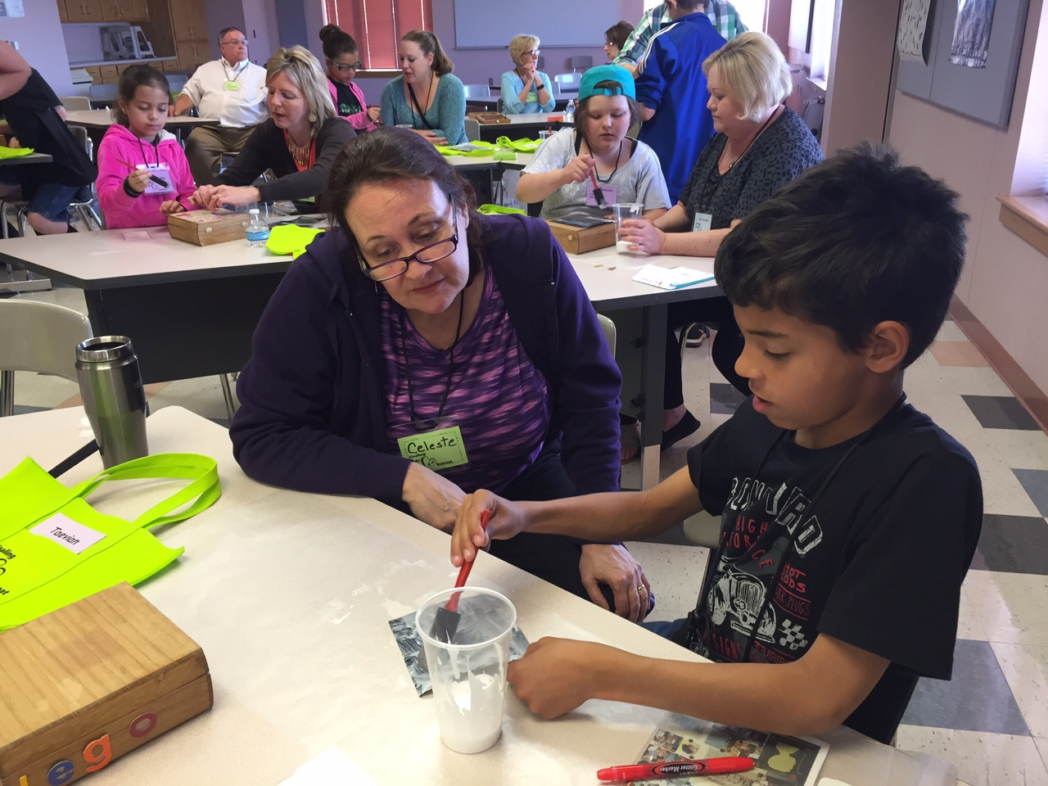

Slide 25
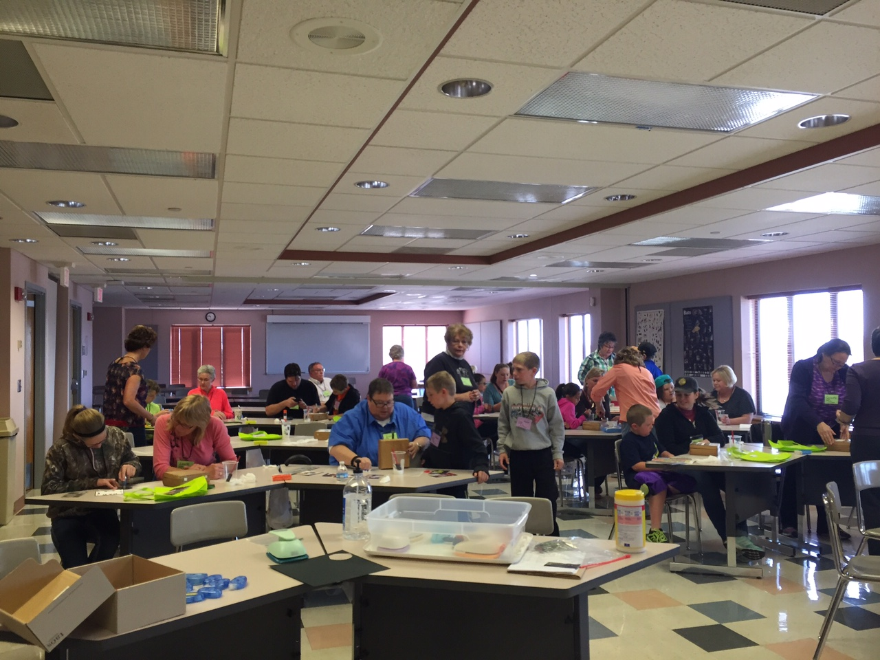

Slide 26
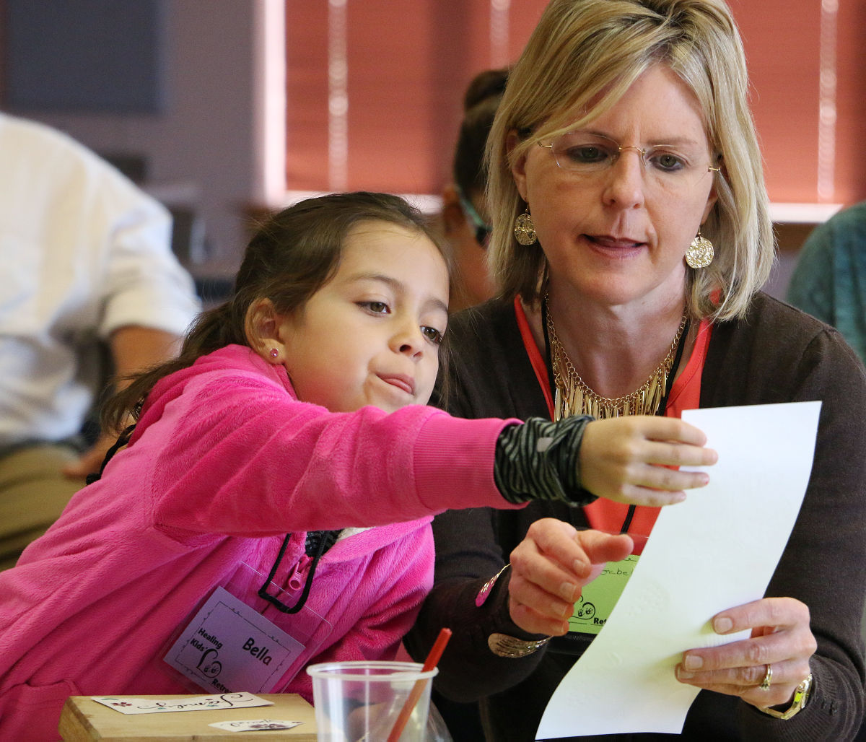

Slide 27
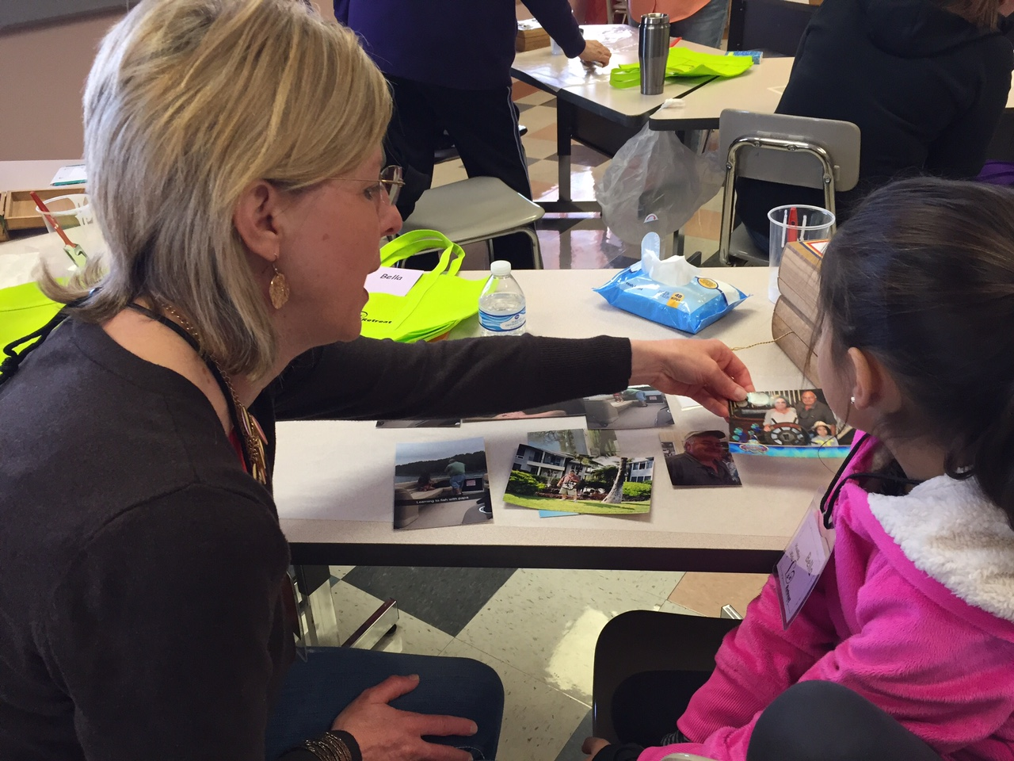

Slide 28
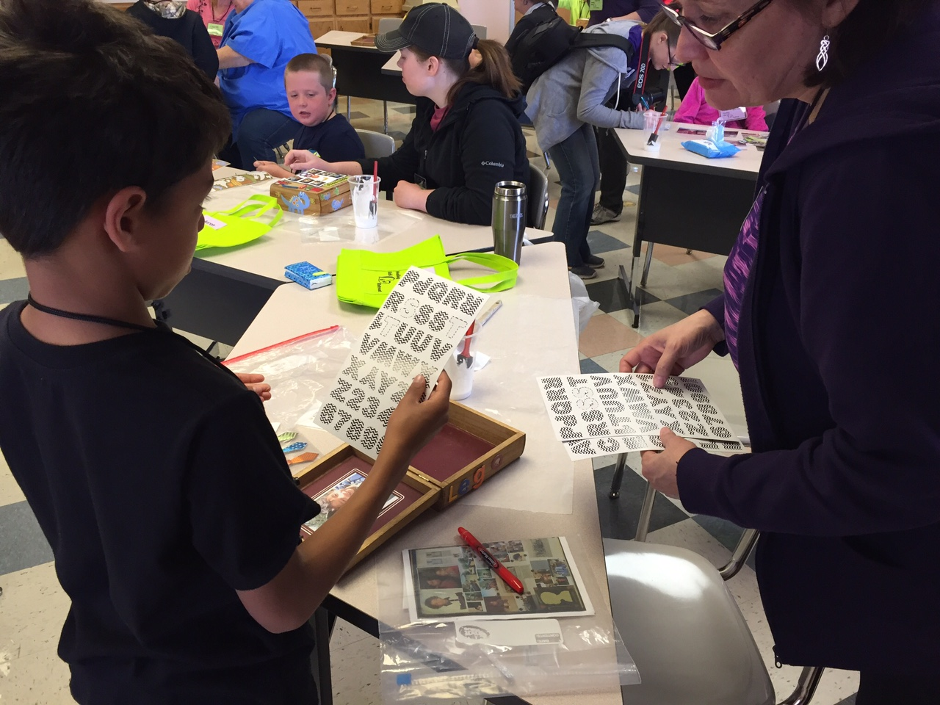

Slide 29
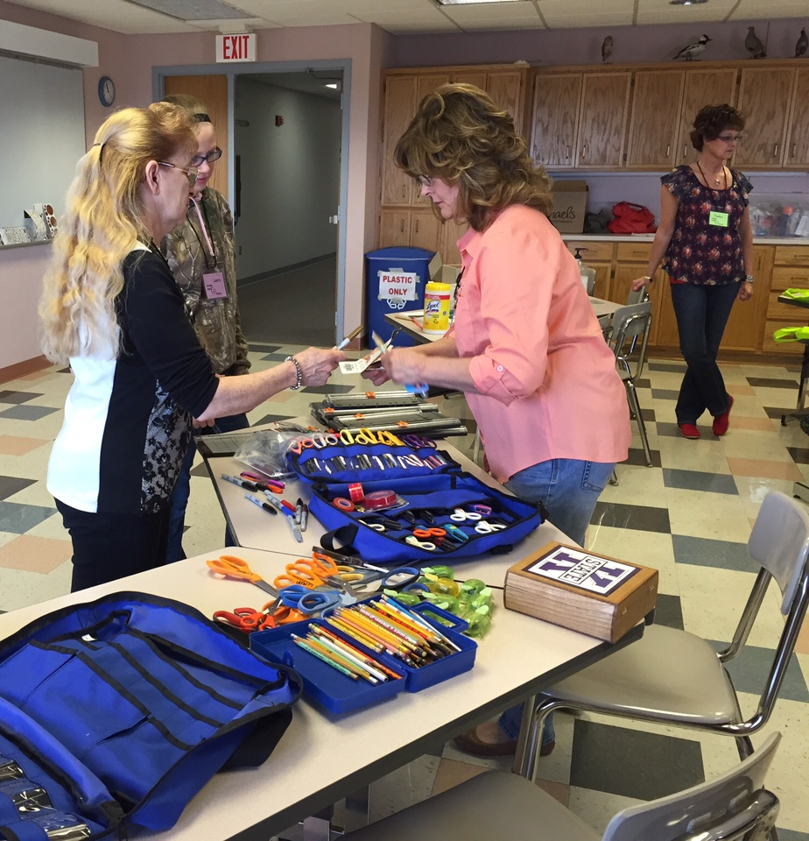

Slide 30
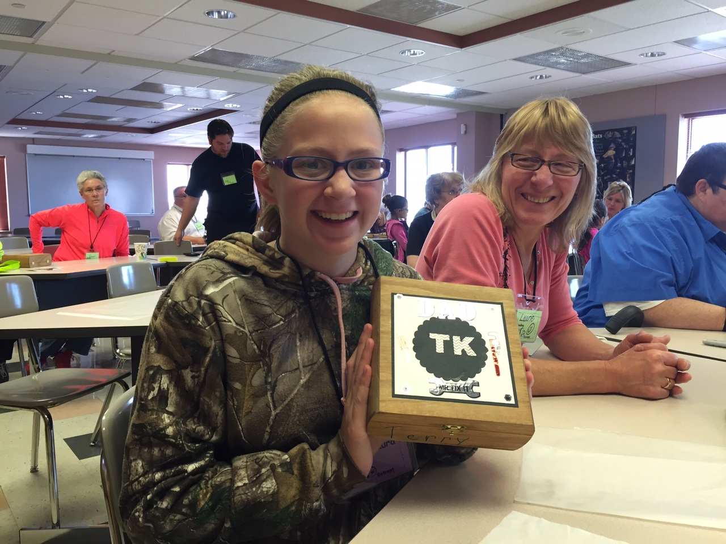
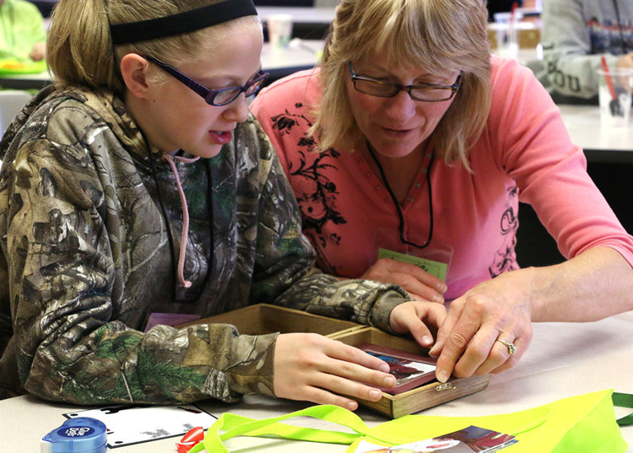

Slide 31
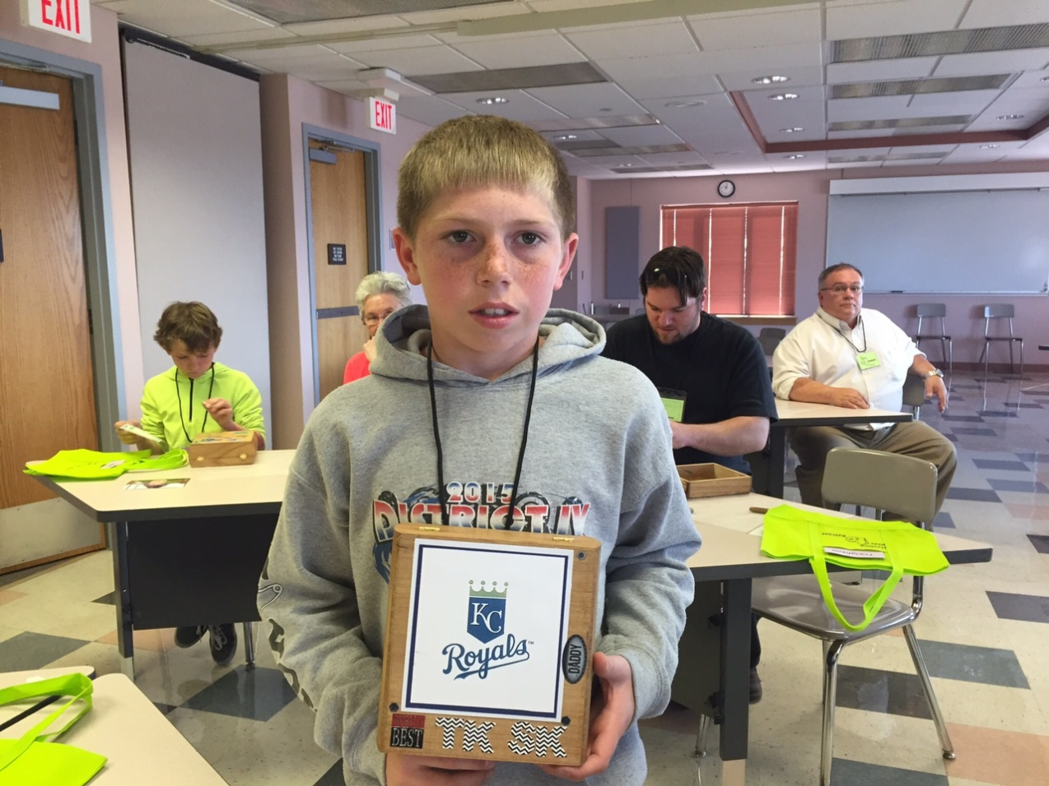
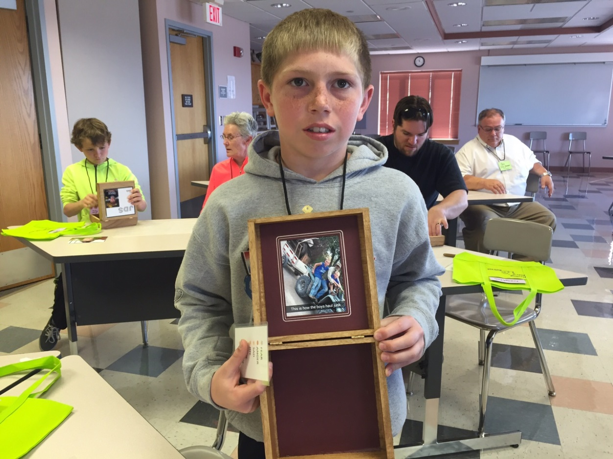

Slide 32
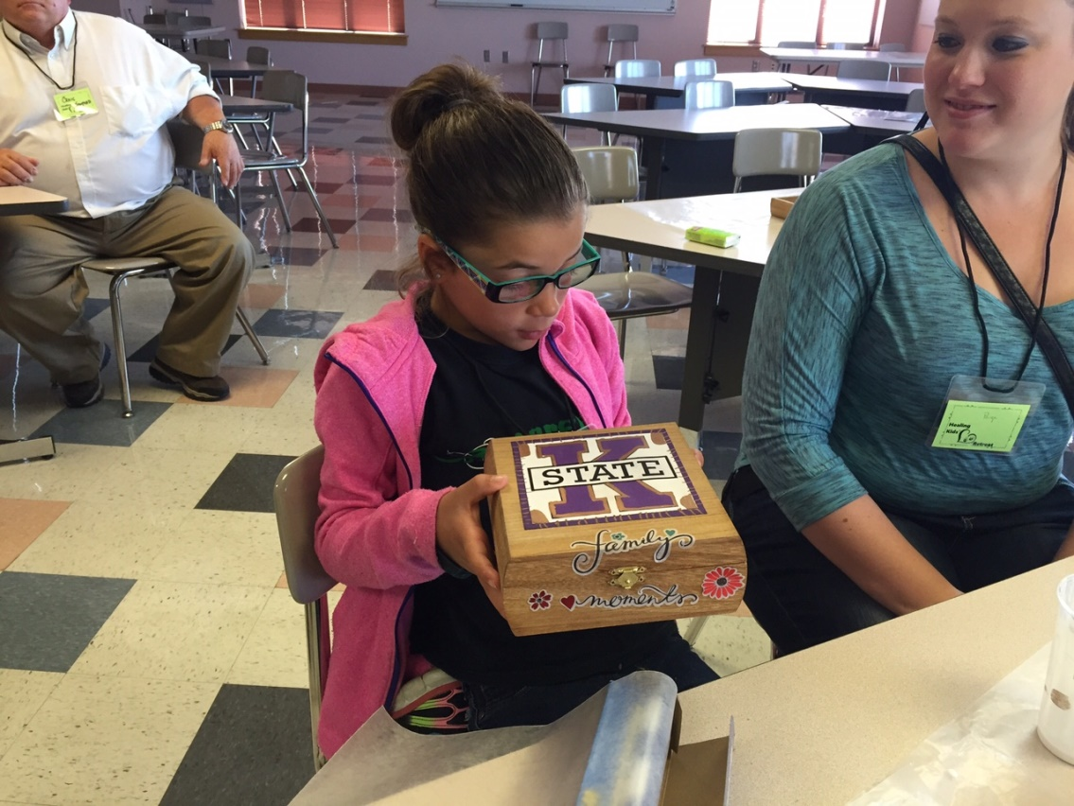

Slide 33
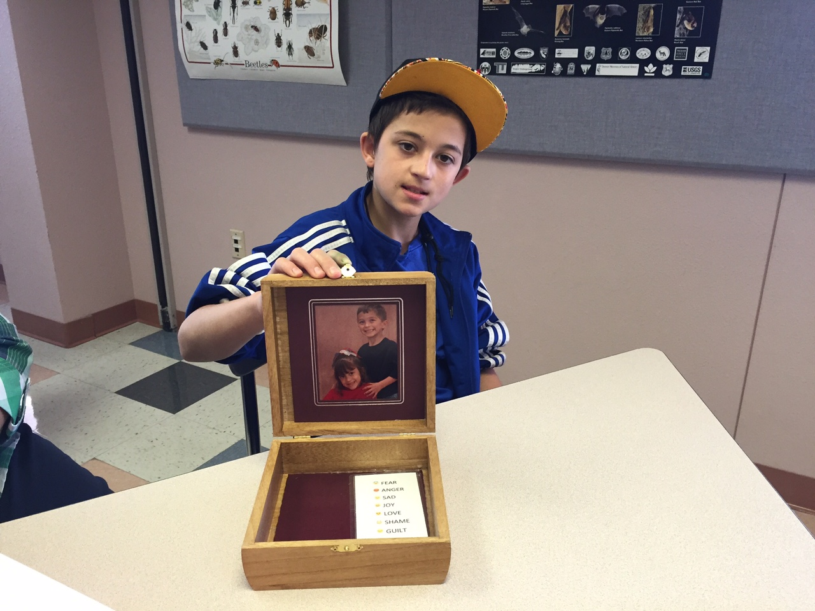

Slide 34
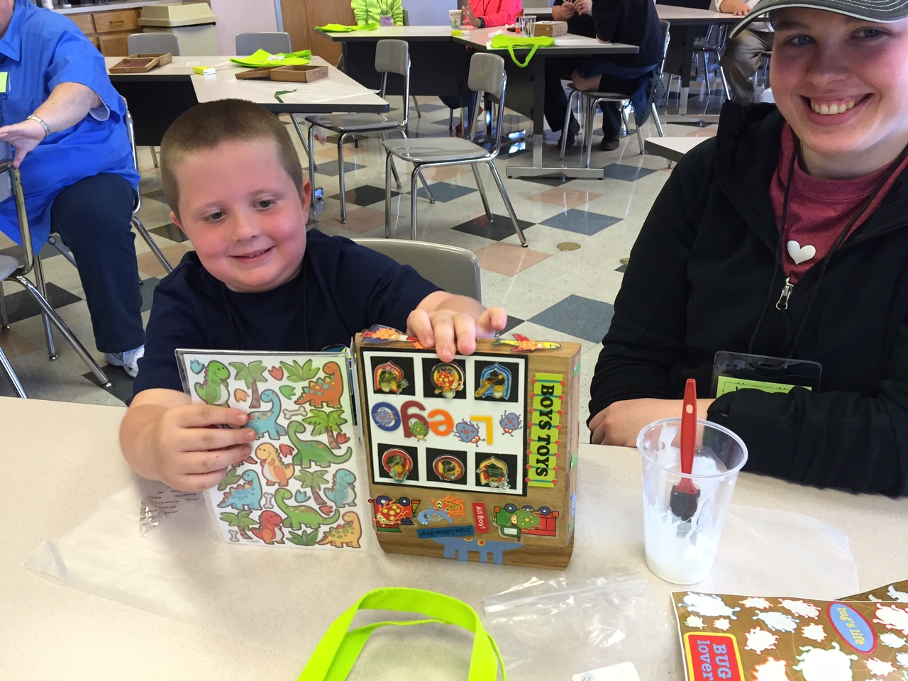
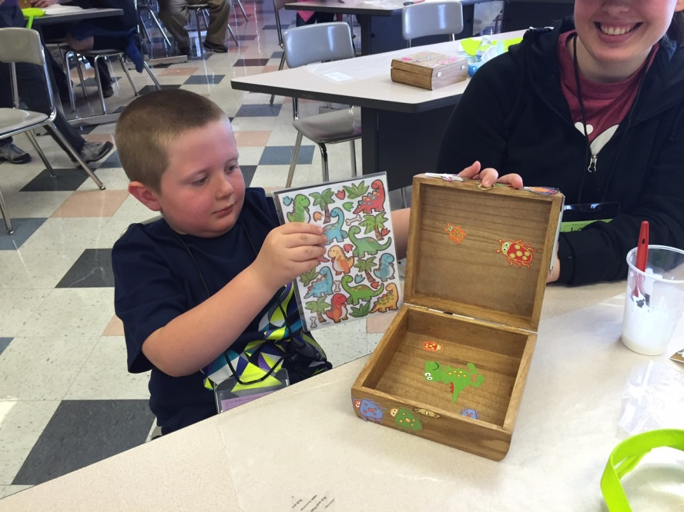

Slide 35
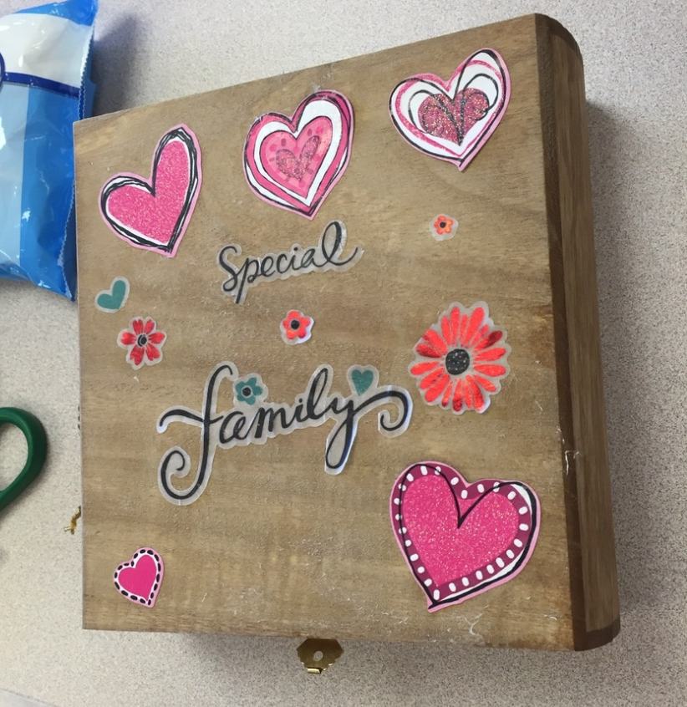

Slide 36
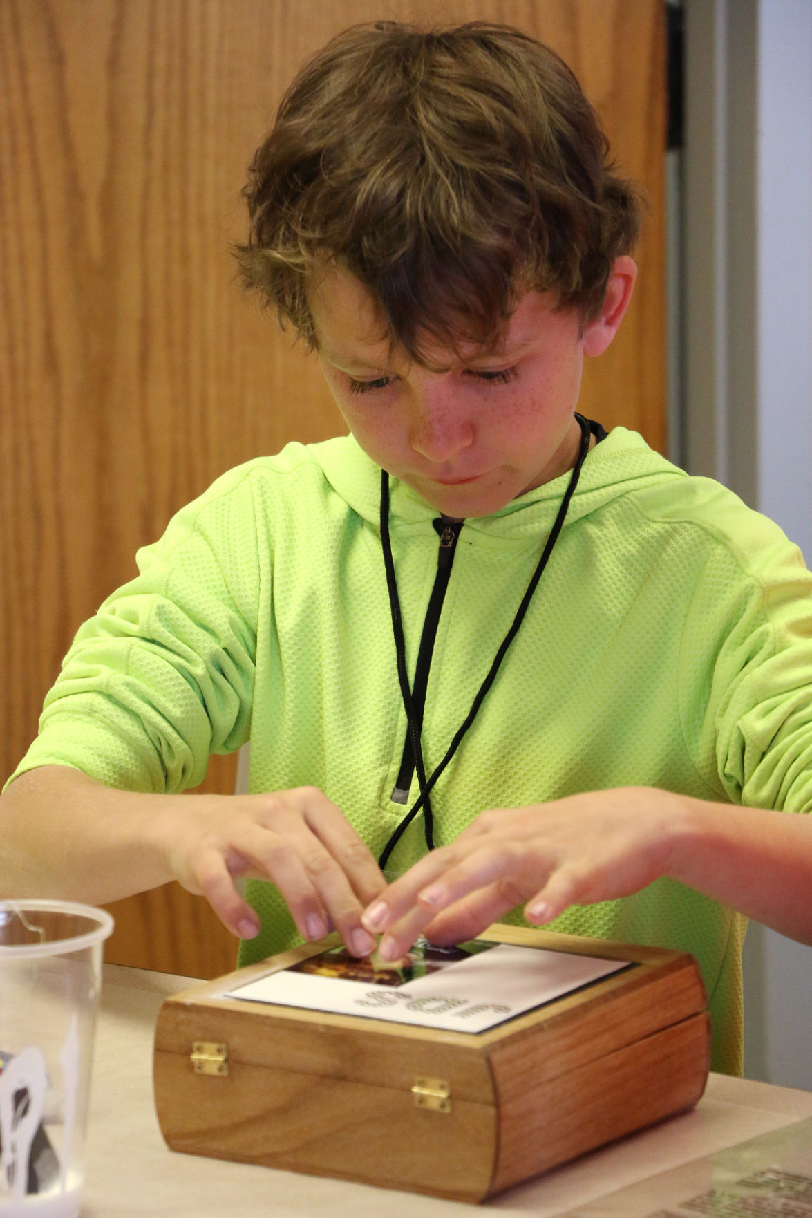

Slide 37
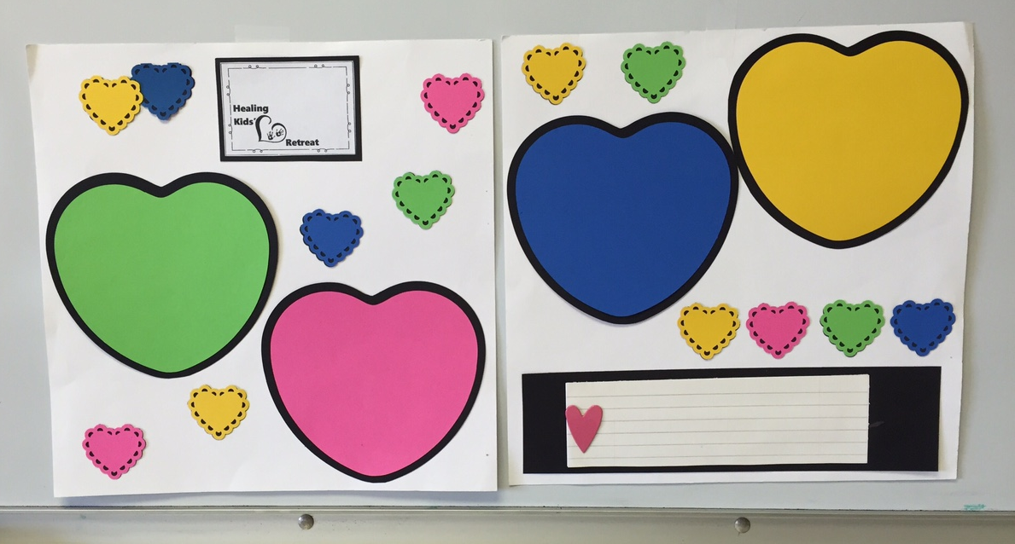
Through making a scrapbook page with pictures brought from home of their loved one, the children have another opportunity to share the stories of their loves ones.

Slide 38
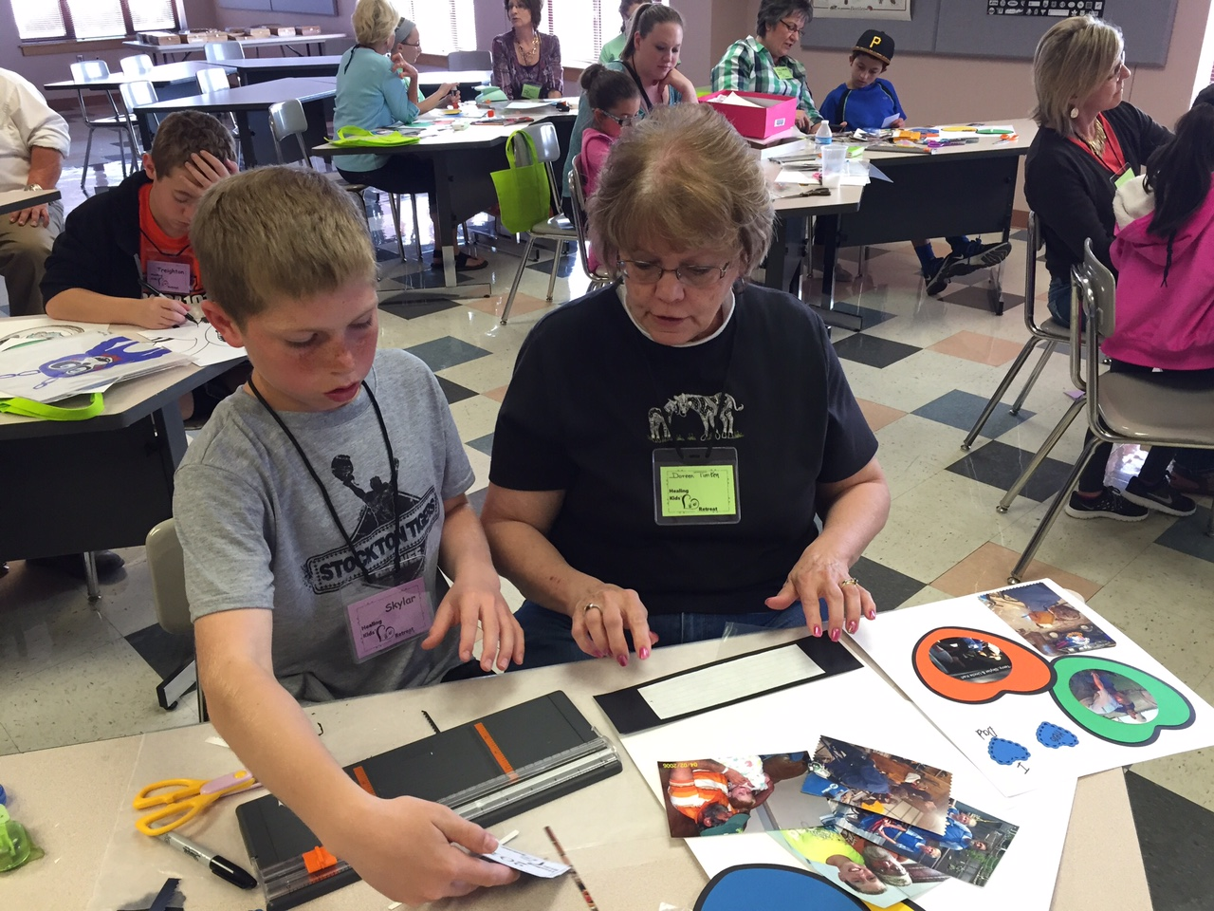

Slide 39
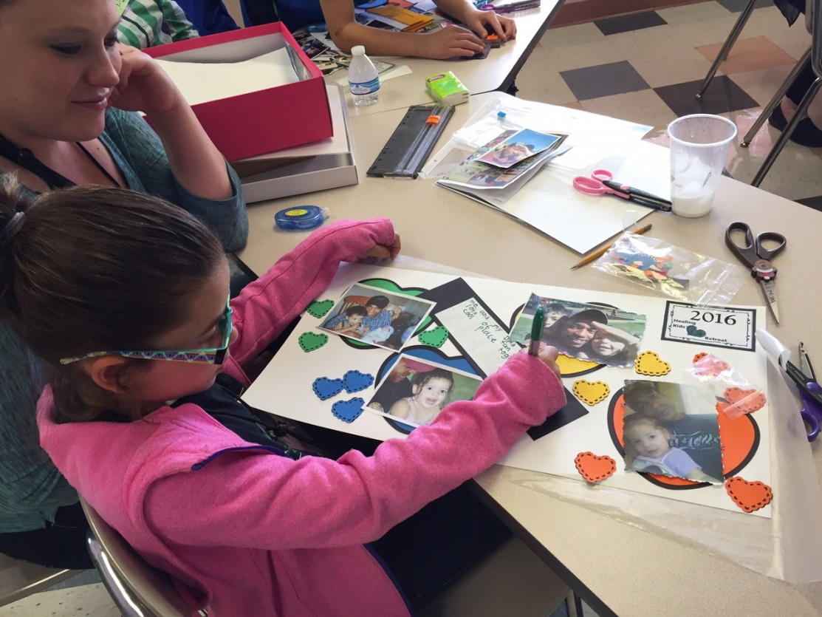

Slide 40
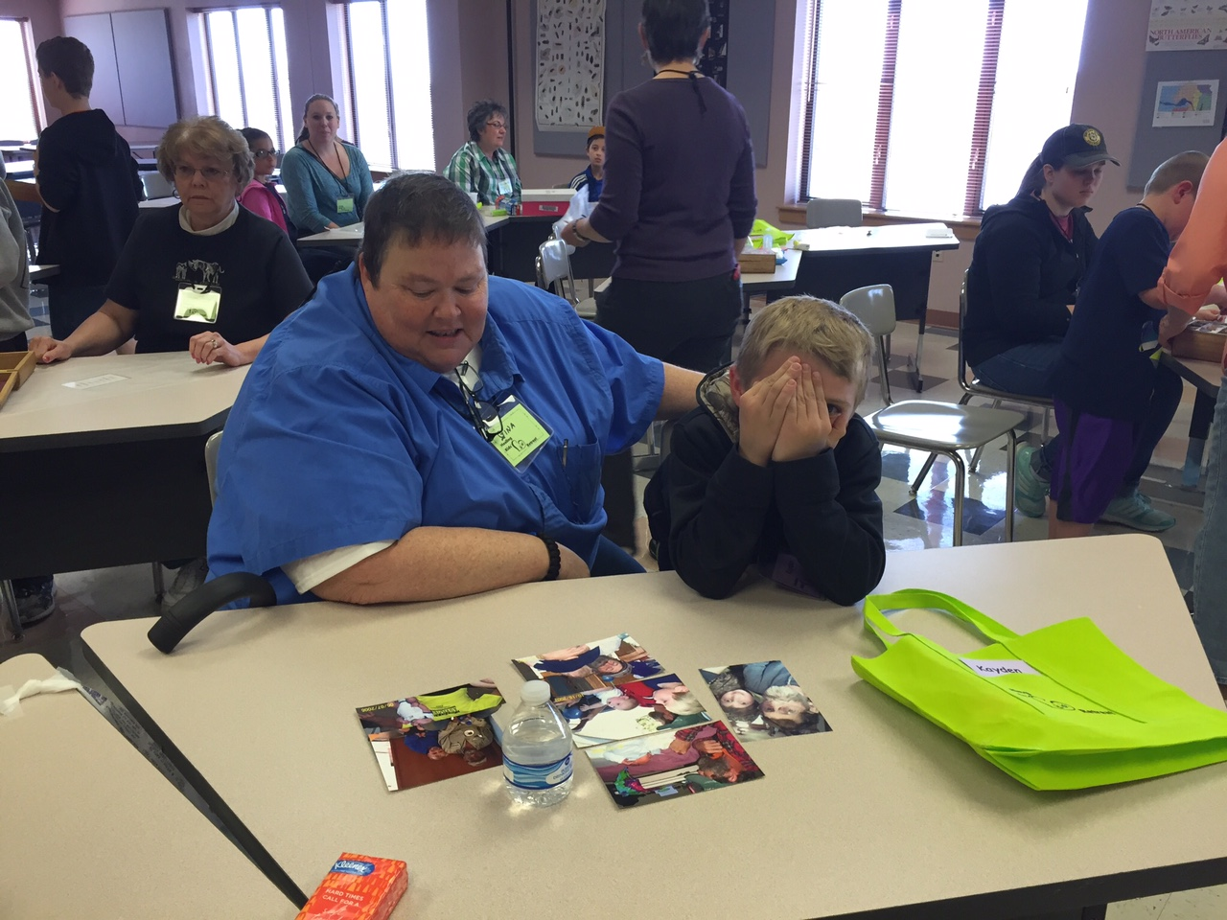

Slide 41
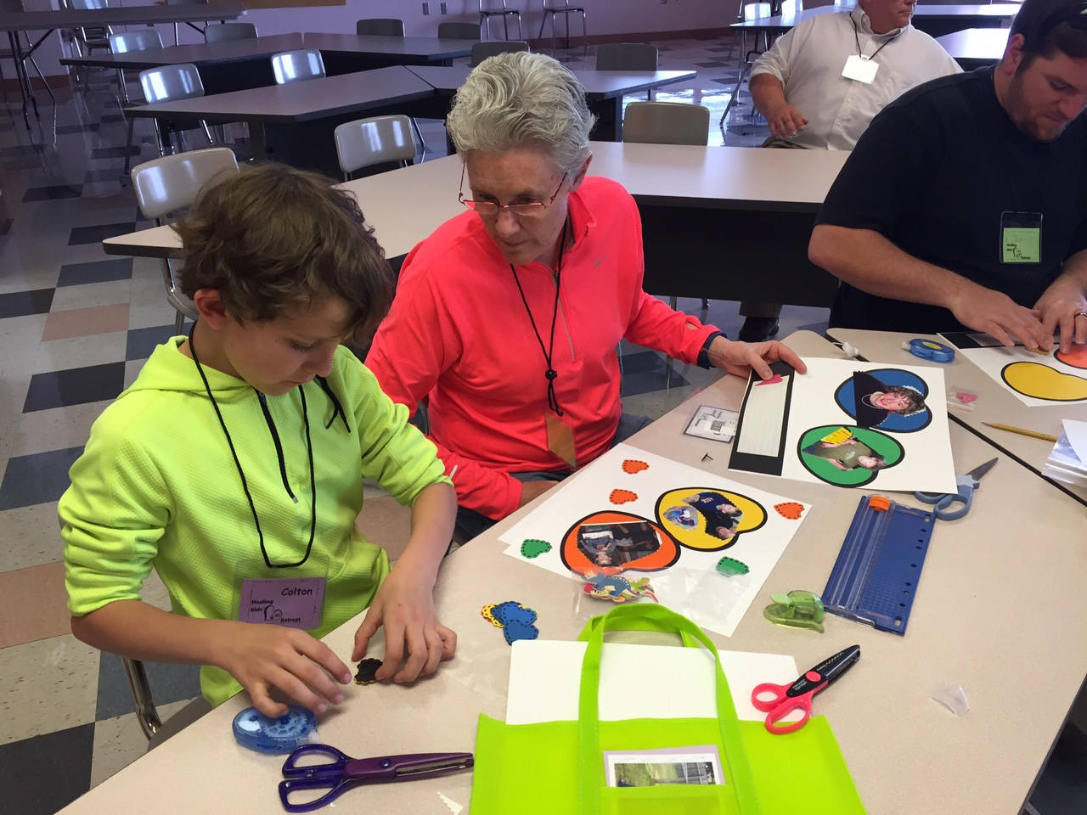

Slide 42
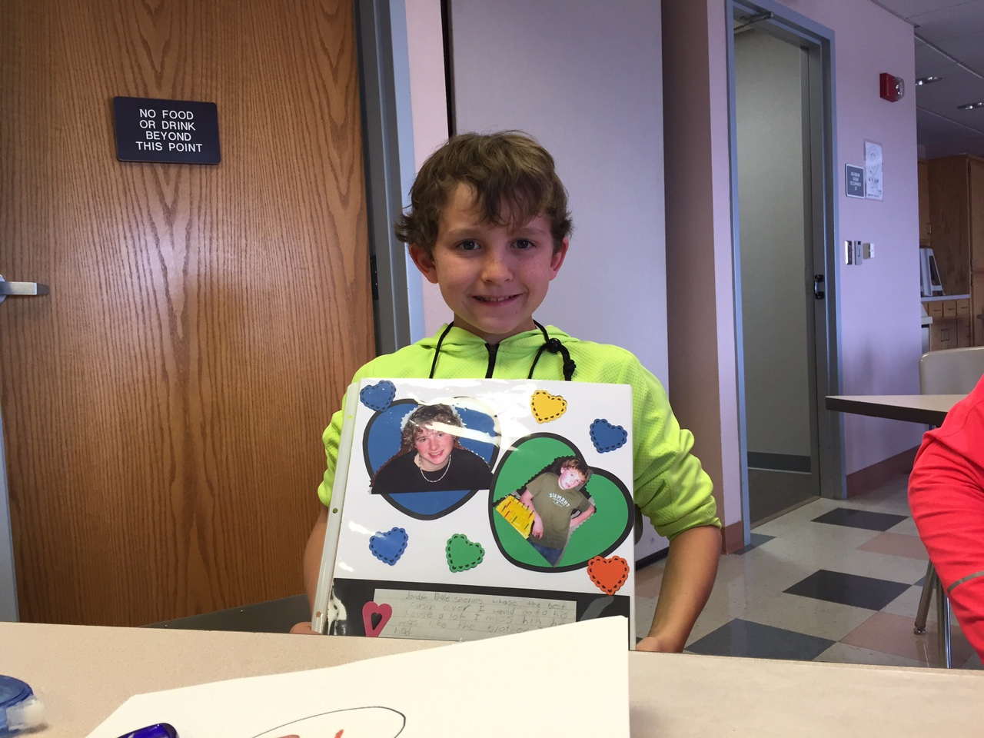

Slide 43
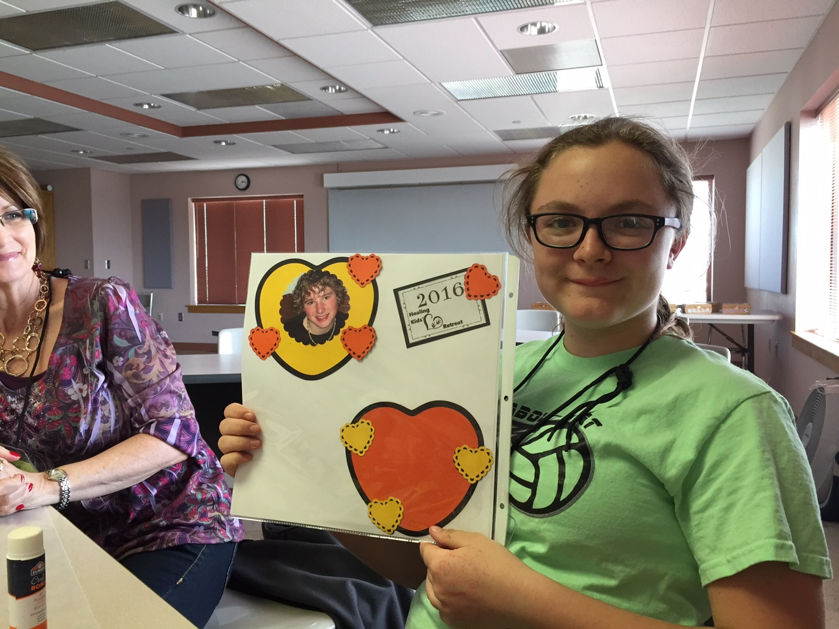

Slide 44
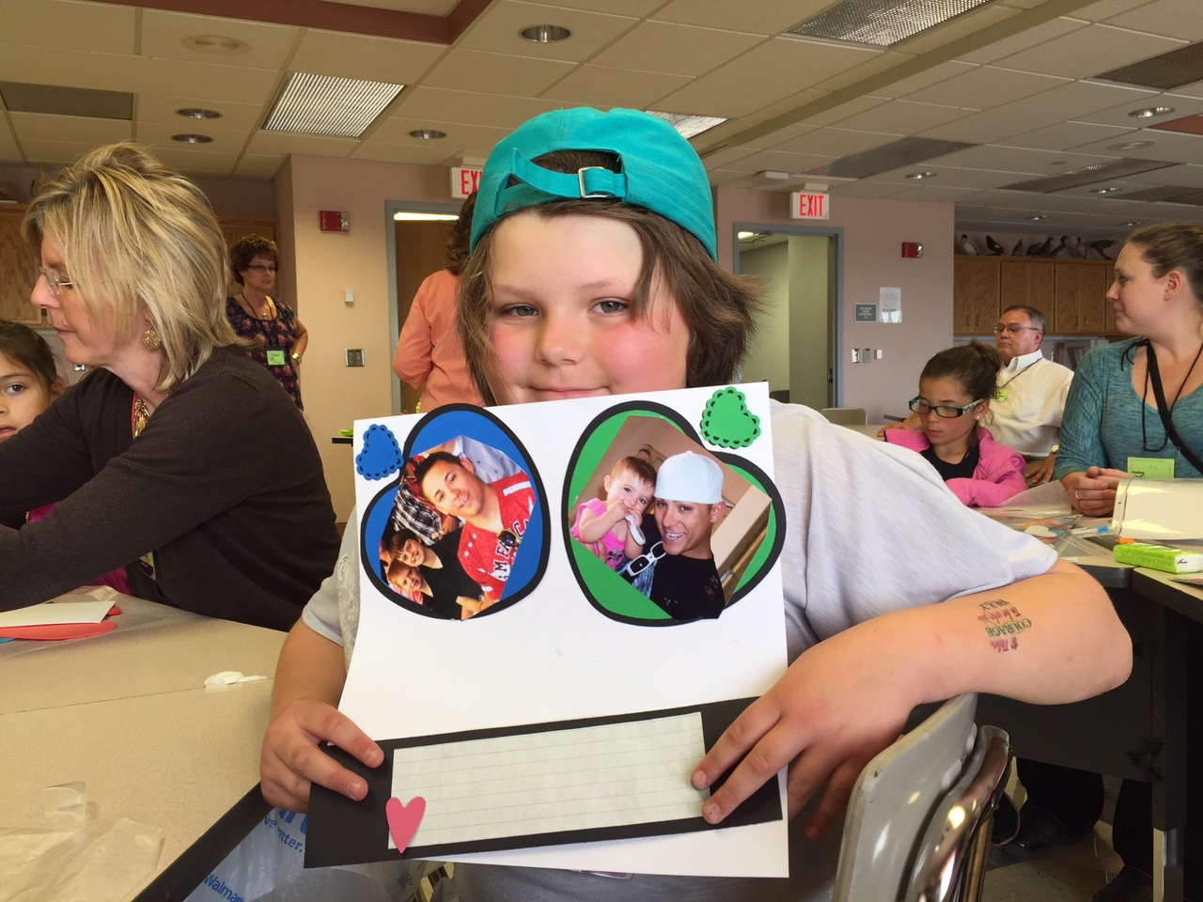

Slide 45
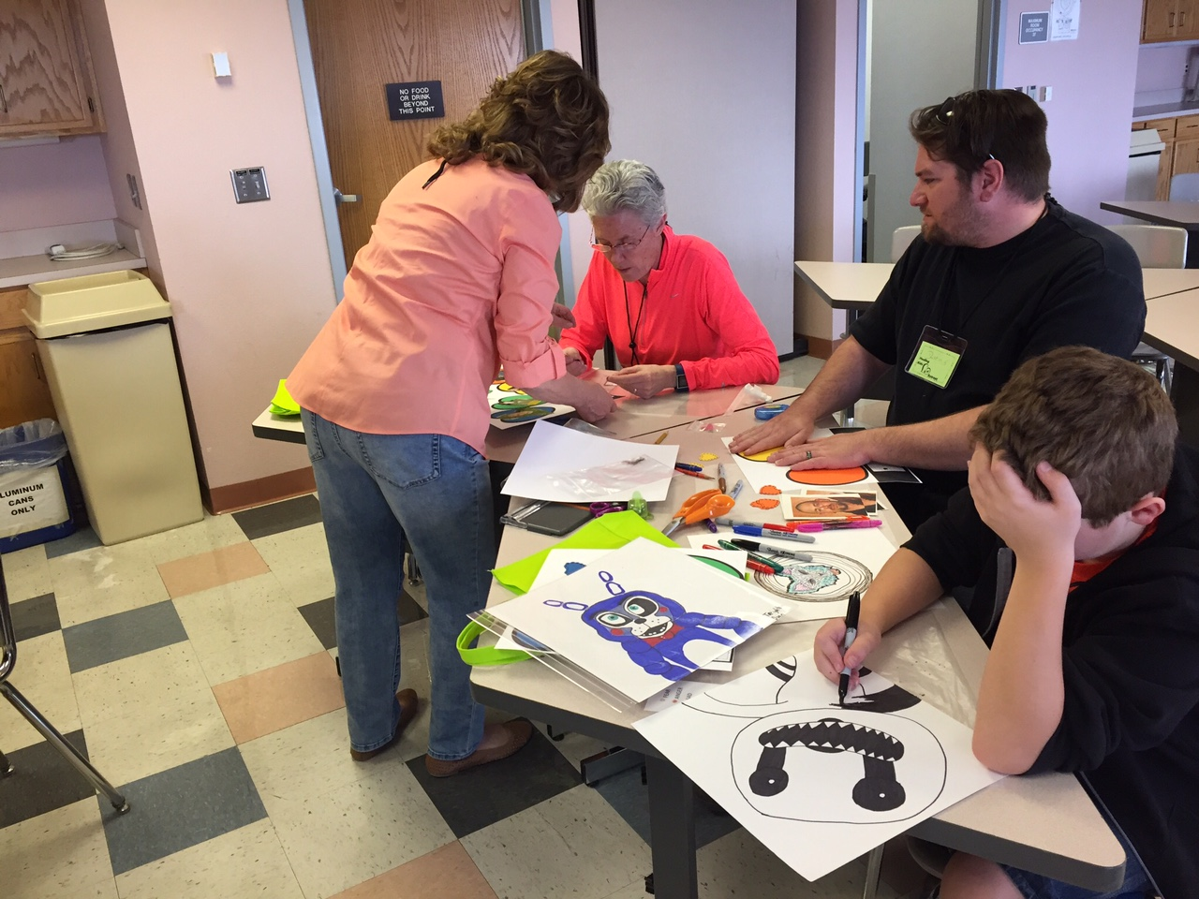
Some of the children express their grief and loss through creative activities such as
free-hand drawing.

Slide 46
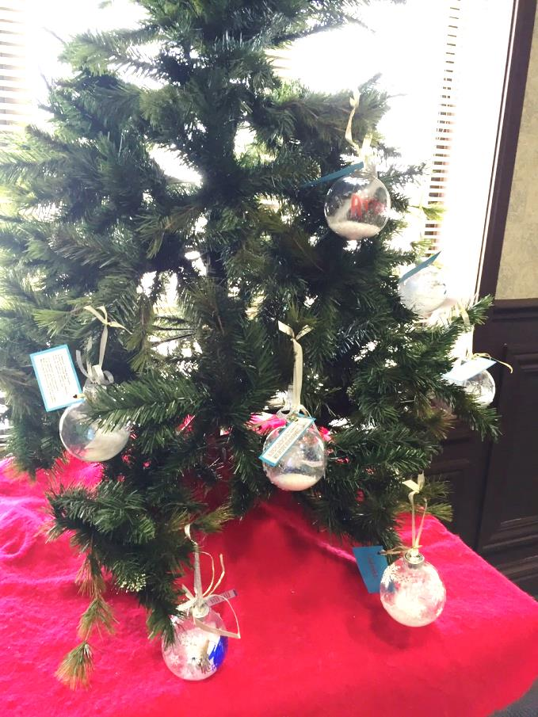
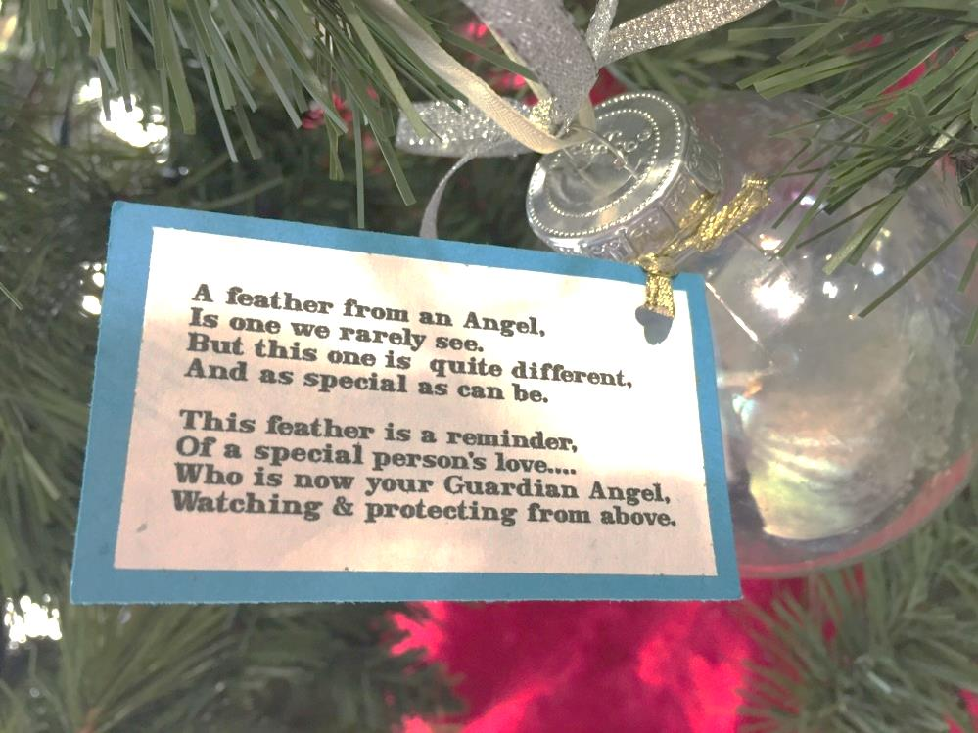
The children also make an ornament to take home to put on the family Christmas Tree to remember and honor their loved one that are especially missed during the
holiday season.

Slide 47
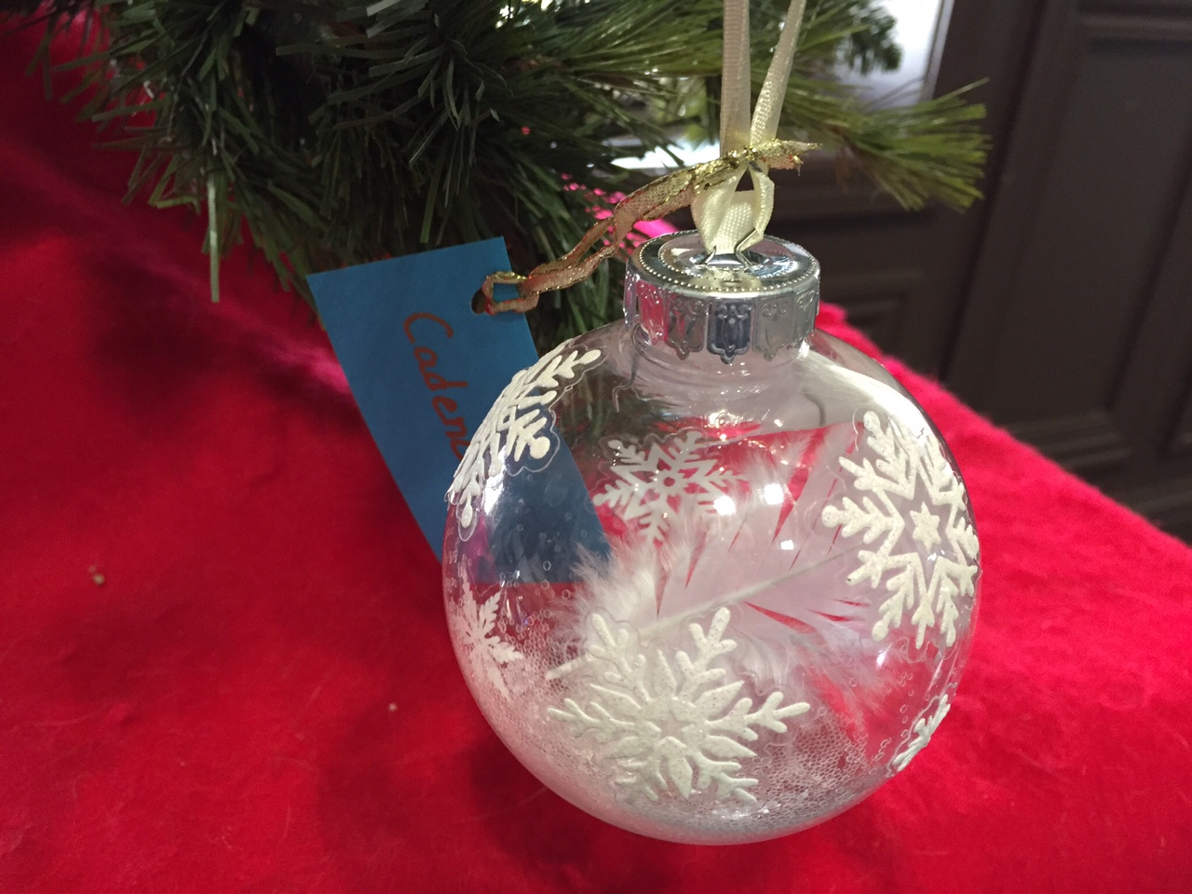

Slide 48
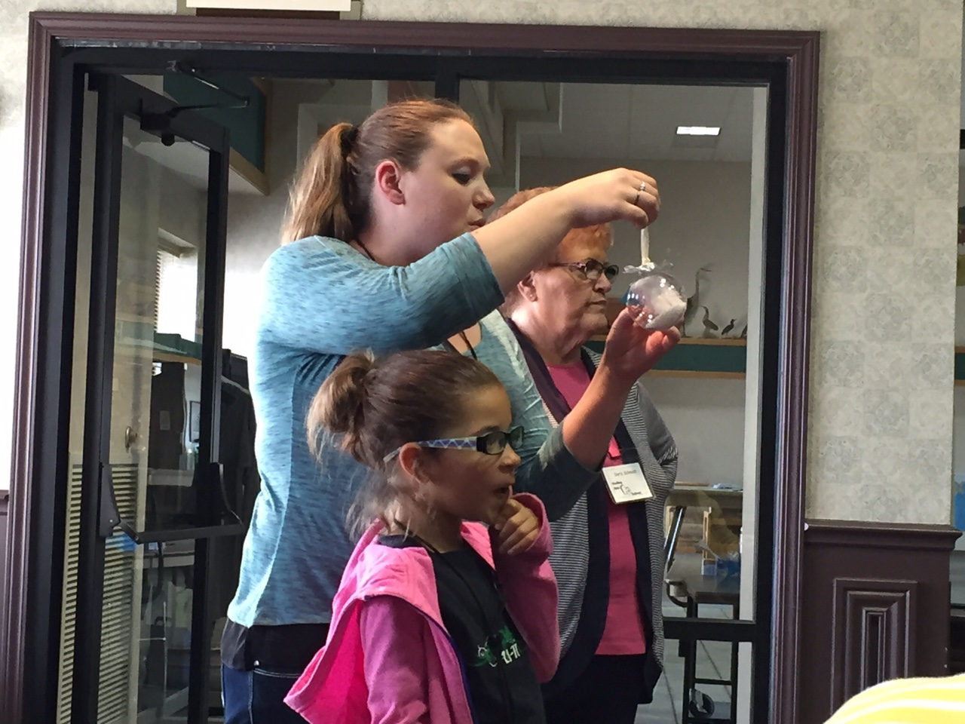

Slide 49
Lunch
A time for children, parents, mentors, and volunteers to make new friends and share special stories.

Slide 50
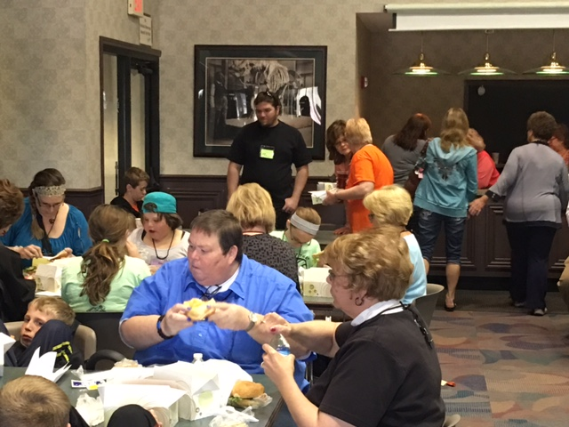

Slide 51
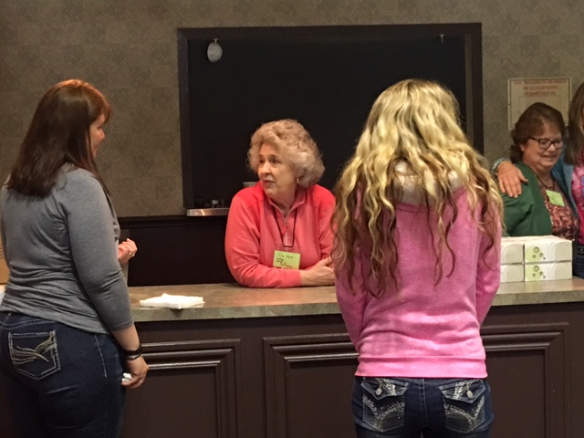

Slide 52
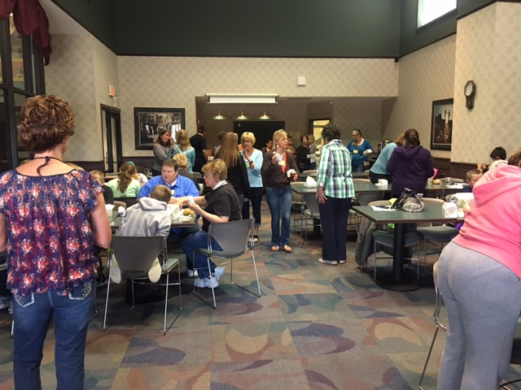

Slide 56
Balloon Launch
A time for letting go of feelings of loss, celebrating the lives of those they love, and taking with them new found friendships brings a positive conclusion to the Retreat for the children, families, and volunteers.

Slide 66
Thank you Karen, Doris, Linda, and Deb for making a dream come true through volunteering your time, talents, and caring
for our children.

Slide 67
Thanks to Myrna Jordan, MSW and Ann Leiker, LBSW, MS
Executive Director of Center for Life Experience for bringing their professional expertise, knowledge and hearts for children and their families experiencing loss and grief to the planning of “Healing Kid’s Hearts.”

Slide 68
A special “Thank You” to all who supported this first annual “Healing Kid’s Hearts Retreat”

Slide 69
For information about the next “Healing Kid’s Hearts Retreat”, you may contact Ann Leiker at
The Center for Life Experience at
785-259-6859.

